Slide 1
GasSense
Gas detector powered by Arduino

Slide 2
Goals
To create simple, yet effective way of encountering life-threatening scenarios where air pollution could occur
To create safer environment for people where the risk of air pollution could be lethal
To build low-cost system, capable of sensing abnormally high levels of air pollution

Slide 3
The project
A simple system for alerting people when air pollution occurs in order to avoid tragic outcomes.

Slide 4
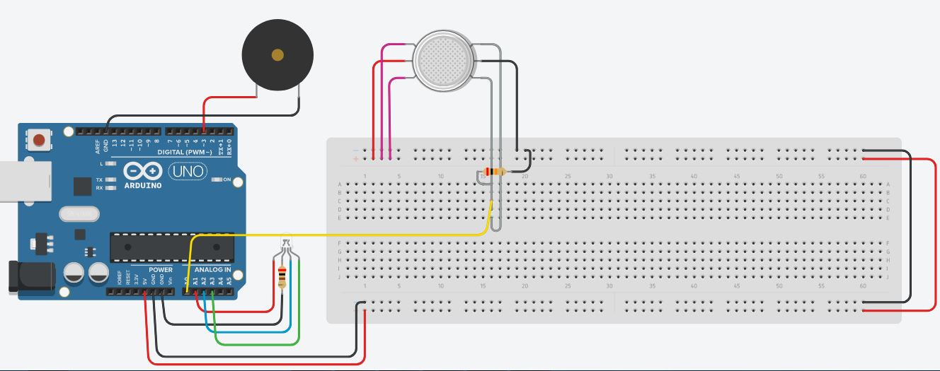
The electric circuit

Slide 5
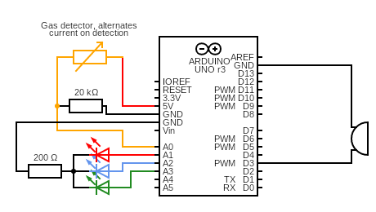

Slide 6
List of items
Arduino Uno R3
Gas detector
Piezoelectric buzzer
RGB LED
1x 200Ω Resistor
1x 20kΩ Resistor
1x Breadboard
20x Jumper wires

Slide 7
Benefits of using GasSense
Safer environment for workers and inhabitants
Quicker response to emergencies
Lower losses from emergency scenarios

Slide 8
Conclusion
Using GasSense system would be beneficial to many and is recommended that every premisis, endangered of air pollution involving toxic or flamable gases, to be equipped with such systems.
GasSense®

